Slide 1
PUBPOL 599: Data-Driven Management and Policy
Foundations of data analytics (in R!) for evidence-based management and policy
José Manuel Magallanes, PhD
Eric van Holm, PhD.

Slide 2
Foundations of data analytics…

Slide 3
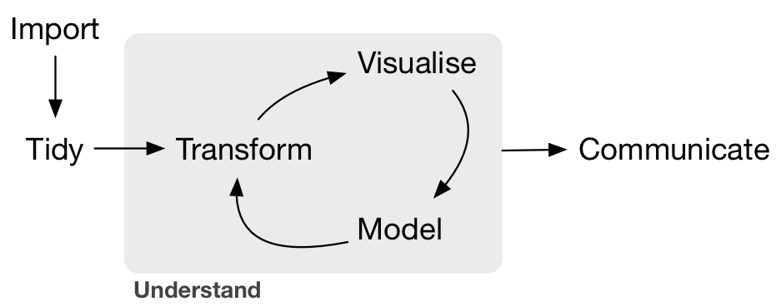
Data science modeling

Slide 4

Statistics is the art of applying complex models to simple (flat) datasets.
Data science is the art of applying simple models to complex datasets.
“Data Wrangling”

Slide 7
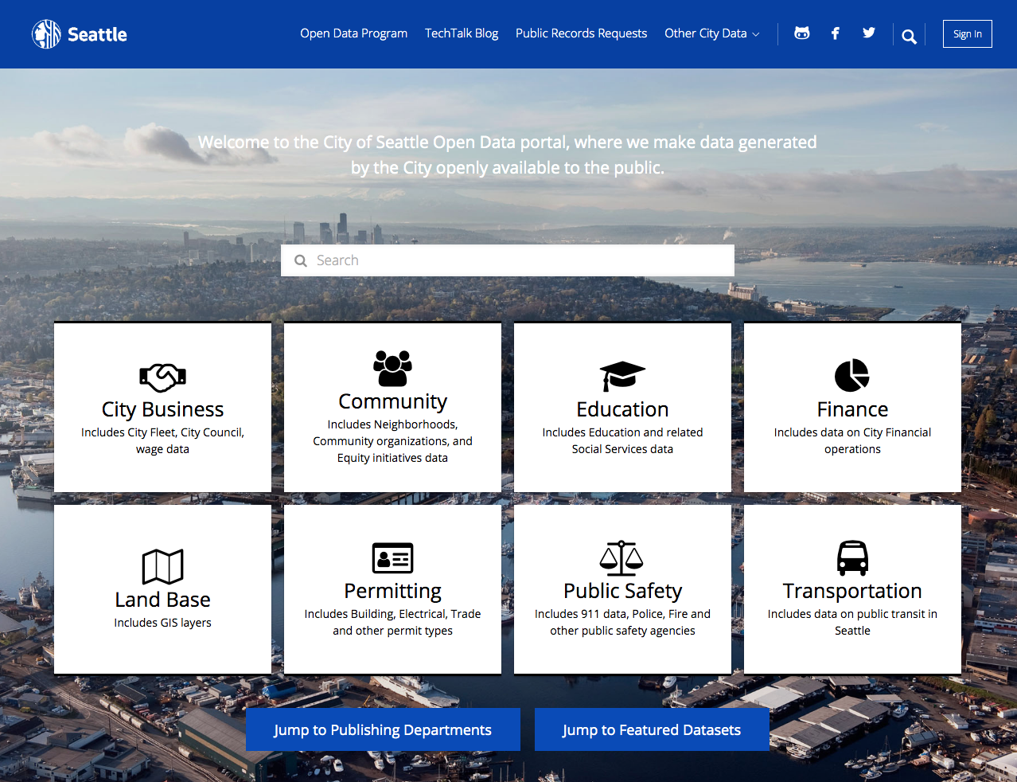
200,000 Open Government Datasets !

Slide 8
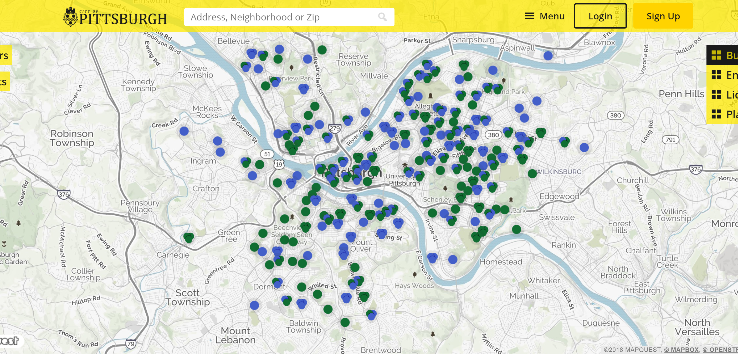
$66,000 license per year!

Slide 9

install.packages( "leaflet" )
library( leaflet )
### LOAD DATA ###
code.violations <- read.csv("https://raw.githubusercontent.com/subartle/orangespot/master/data/code%20violations.csv")
lat.lon <- code.violations[ c("lat","lon") ]
lat.lon <- na.omit( lat.lon )
### CREATE MAP ###
syr.map <- leaflet(data=lat.lon ) %>%
addProviderTiles("CartoDB.Positron", tileOptions(minZoom=10, maxZoom=17)) %>%
setView(lng=-76.13, lat=43.03, zoom=13) %>%
setMaxBounds(lng1=-75, lat1=41, lng2=-77, lat2=45)
syr.map
### COLOR CODE BED BUGS ###
col.vec <- ifelse( code.violations$Complaint.Type == "Bed Bugs", "orange", NA )
addCircles( syr.map, lng = lat.lon$lon, lat = lat.lon$lat, col=col.vec )
(you can build a similar platform with 12 lines of code)

Slide 10
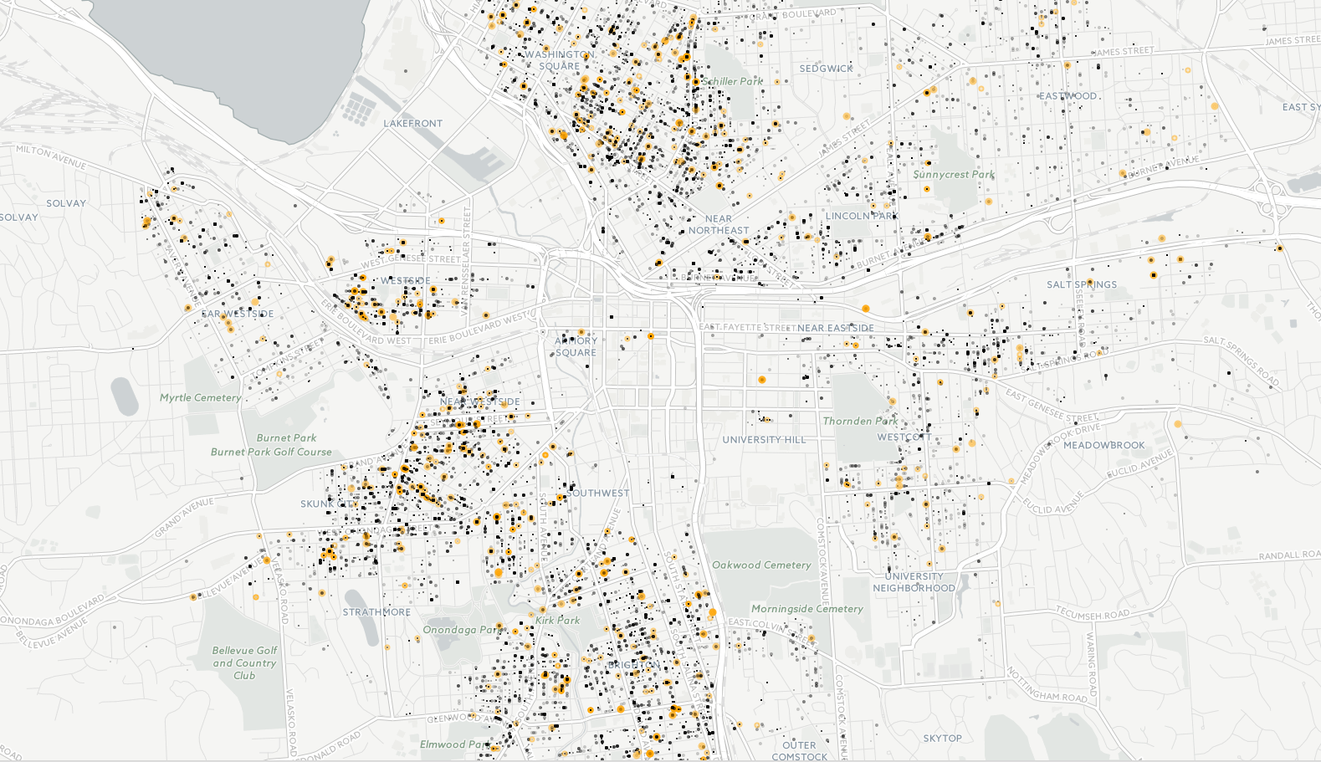
Compare to: https://pittsburghpa.buildingeye.com/building

Slide 11
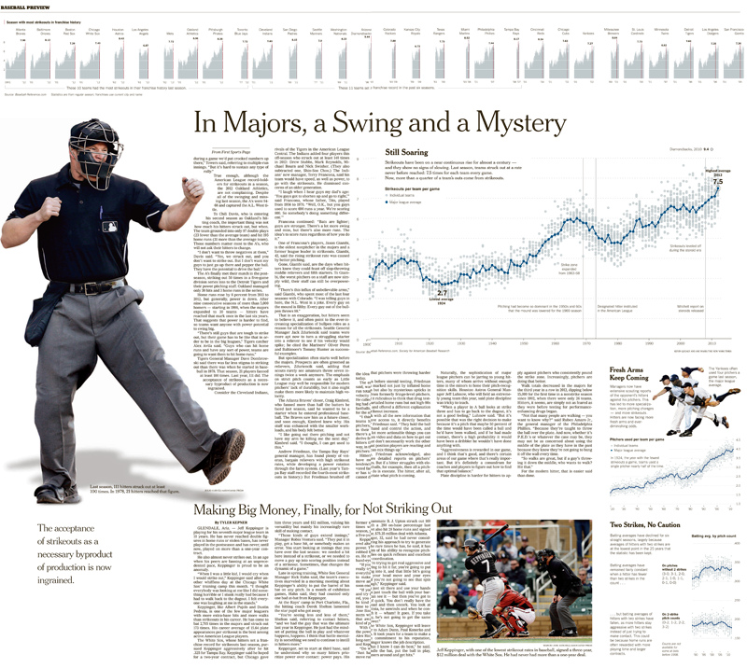

Slide 12
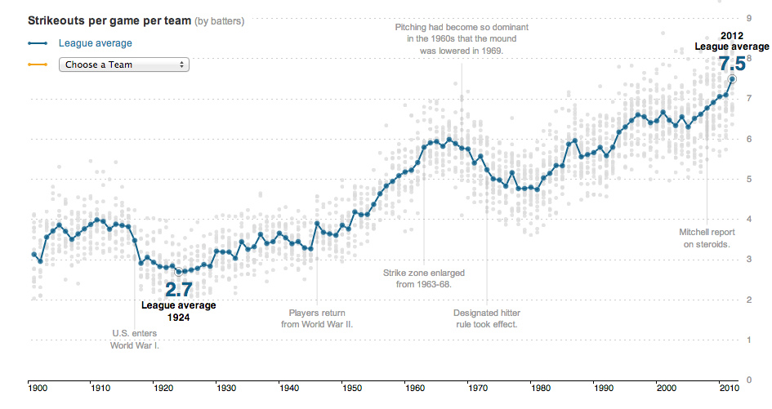
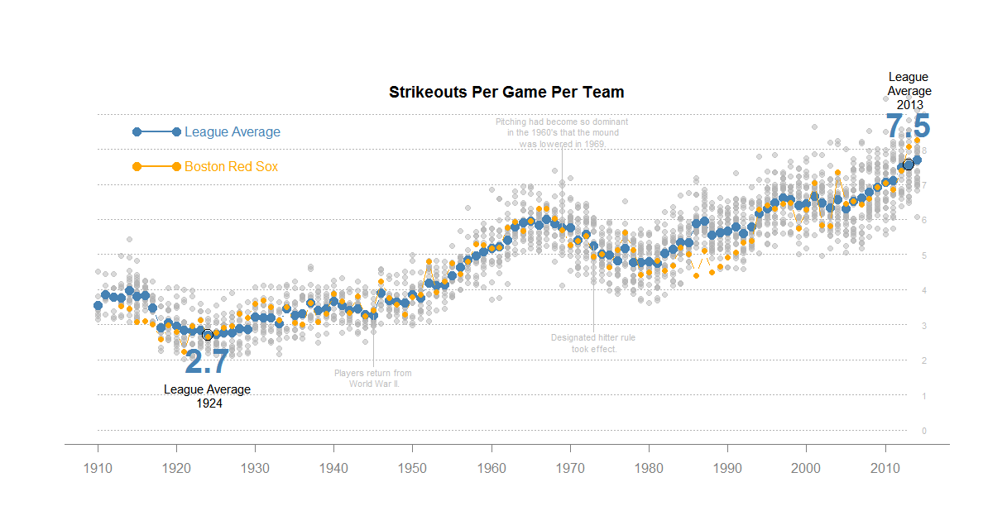
From the NYT Blog, chartsnthings
From A class assignment
http://chartsnthings.tumblr.com/post/47670081904/climate-change-crowbars-and-strikeouts

Slide 13
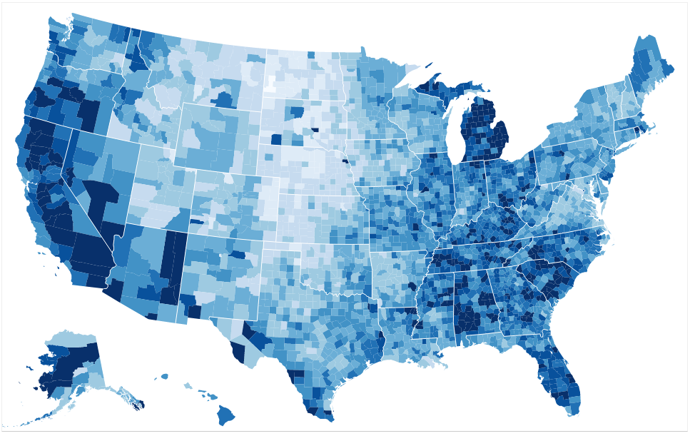
Geographic information systems

Slide 14
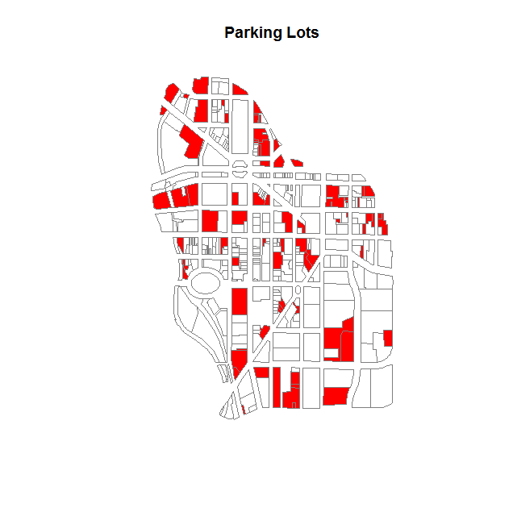
library( maptools )
library( sp )
syr <- readShapePoly( fn="01-05-2015", proj4string=CRS("+proj=longlat +datum=WGS84") )
these.downtown <- syr$Nhood == "Downtown"
downtown <- syr[ these.downtown , ]
these.downtown[ is.na(these.downtown) ] <- F
downtown <- syr[ these.downtown , ]
dat.dt <- as.data.frame( downtown )
color <- ifelse( dat.dt$LandUse == "Parking", "red", NA )
plot( downtown, border="gray80", col=color, main="Parking Lots" )
(9 lines of code)

Slide 15
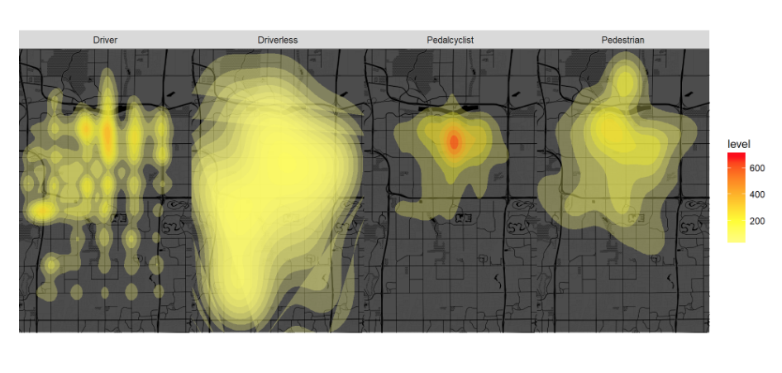

Slide 16
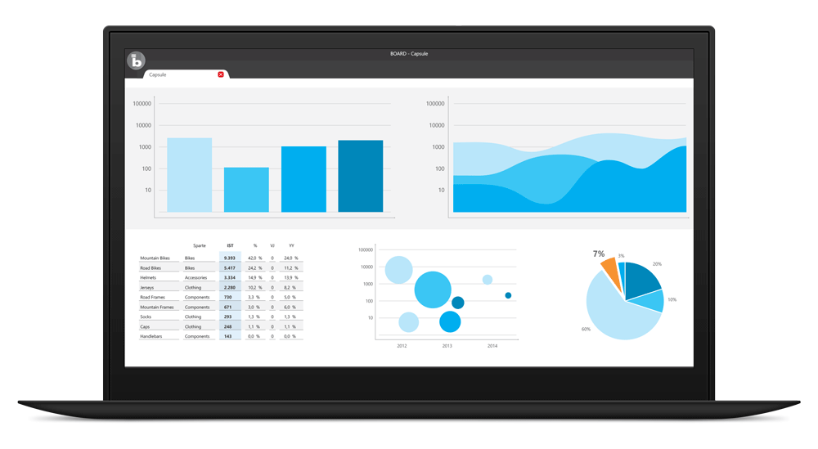
dashboards

Slide 17
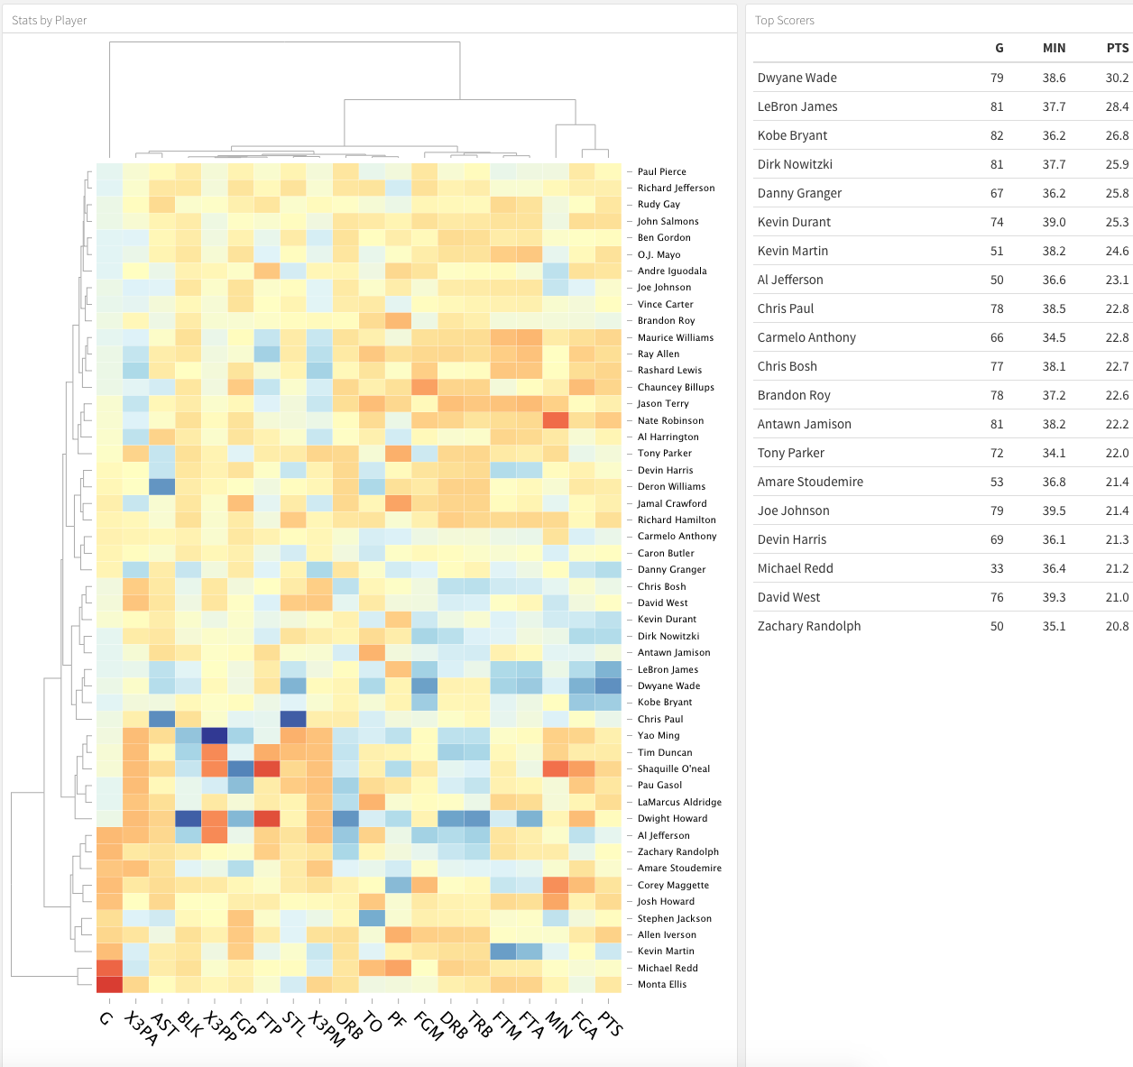
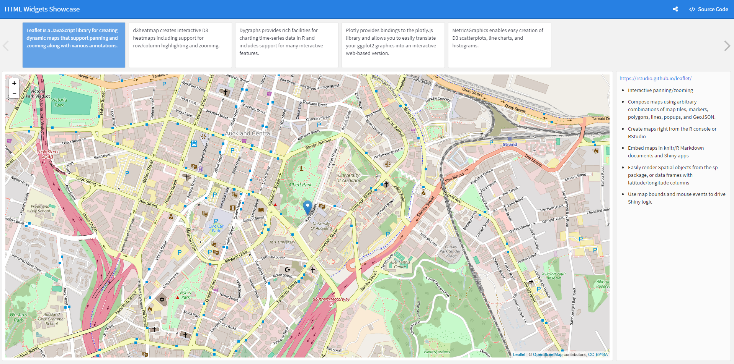
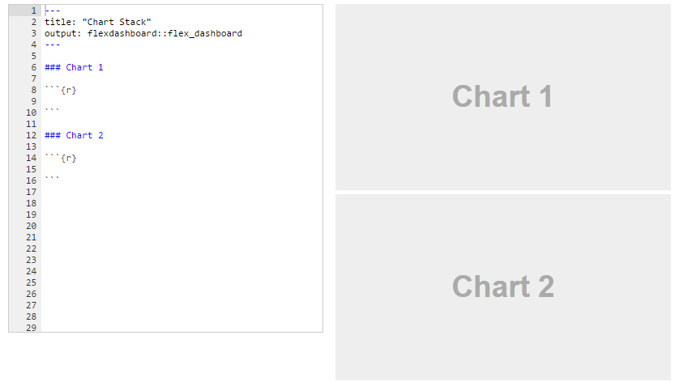
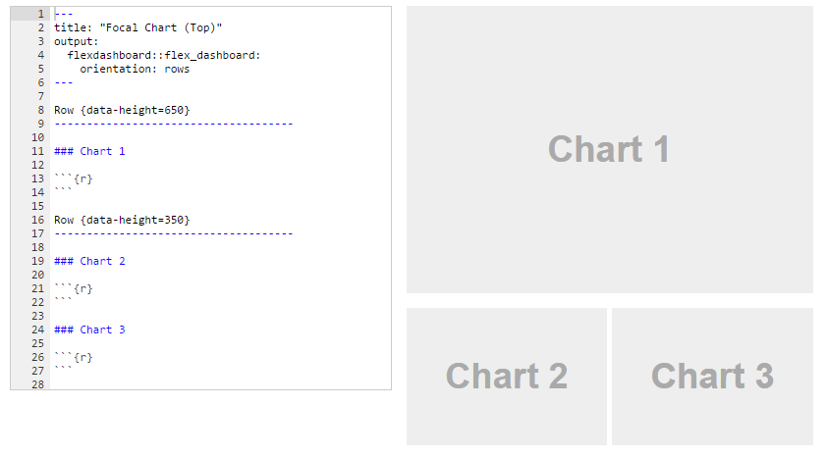

Slide 18
Foundations of data analytics…
(in R!)

Slide 19
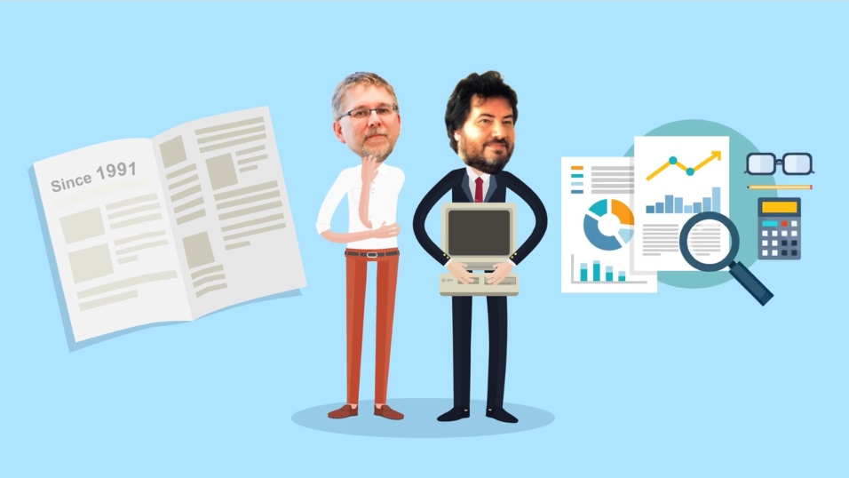
R
Notes:
Two guys in New Zealand who do not know how to program invent a language, give it away for free. It develops a cult following and takes on billion dollar industry giants like SAS and Stata.

Slide 20






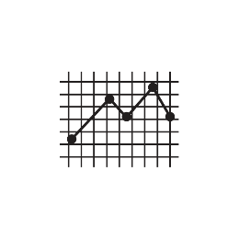



Data science ecosystem
Dynamics
Web Applications
(Dashboards)
Stack
Overflow
Data APIs
Statistics
Open Data
Graphics
(operating system)
Data-Driven Documents
GIS
GitHub

Slide 21
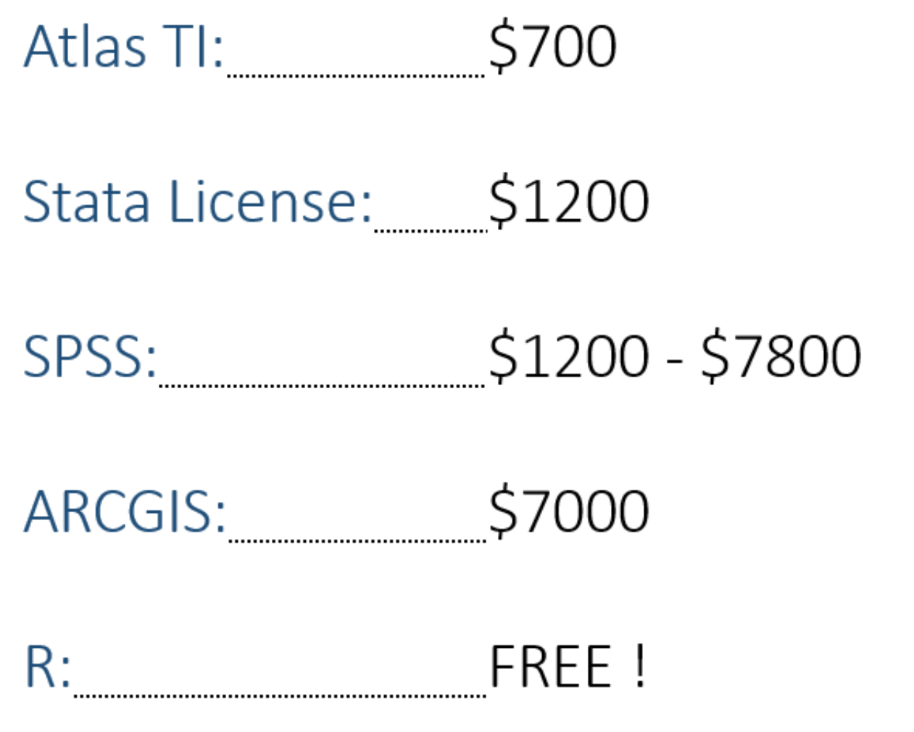
Data science ecosystem

Slide 22

R is a community
Transforming science through open data

Slide 23
Foundations of data analytics…
(in R!)
for evidence-based management and policy

Slide 24
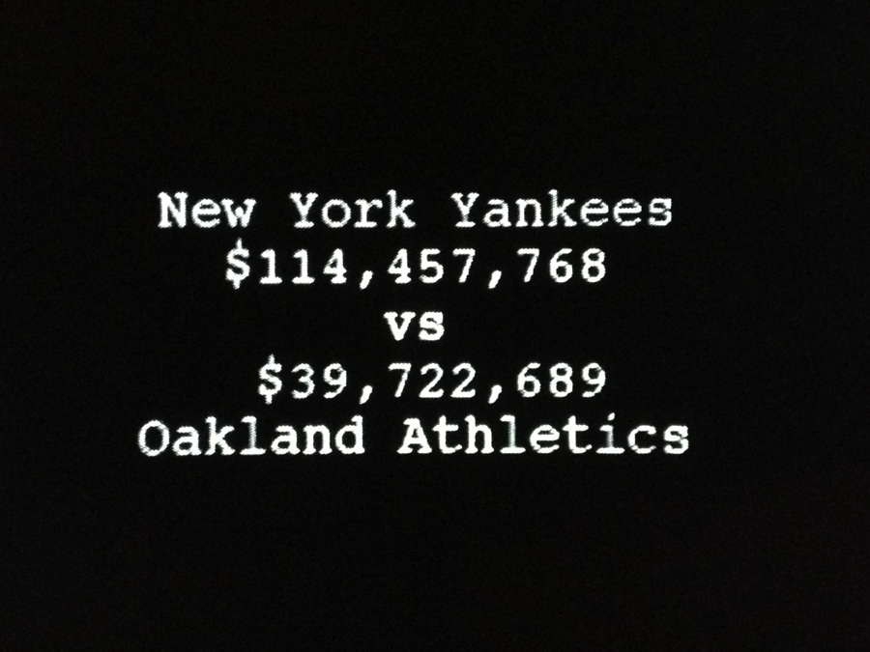
Can government play moneyball?

Slide 26
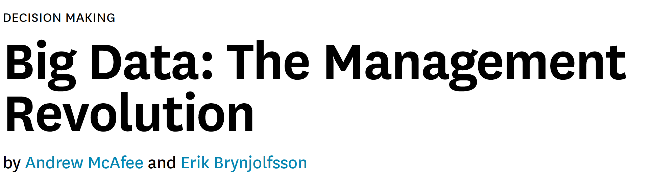
What’s Changed with big data?
Organizations have always used data, but the difference now is the (1) volume, (2) velocity, and (3) variety of data.

Slide 27
Overview of the Course

Slide 28
Course Objectives
Three big goals:
Understand the basics of the R language
Be able to produce quality visualizations through a dashboard to ease decision making
Understand how to use data to improve performance
How much can I learn in a semester?

